Slide 1
Deshi Gadgets
Your Simple Choice for Electronics in Bangladesh

Slide 2





My Teammates,
Md Mehedi Hasan
Mahmuda Adeeba Tul Husna
Mehedi Hasan Pranto
21225103334
21225103333
21225103357
Abdullah Al Hill Baki
Mushfiqur Rahman Pulok
21225103341
21225103525

Slide 3
INTRODUCTION
“Deshi Gadgets" is a comprehensive e-commerce website designed for the online sale of electronic products. This project aims to provide users with a seamless shopping experience where they can browse a wide range of electronics, filter products by categories, add items to their cart, and make purchases through a simulated payment gateway. Additionally, it includes administrative functionalities to manage product listings and inventory.

Slide 4
Objective
01
User-Friendly Shopping Experience
02
Secure Transactions
03
Admin Control and Inventory Management
04
Automated Mailing

Slide 5
Features
User Features Secure login & registration. Product search, browse, and detailed views. Shopping cart & secure payments. View order details & tracking. Automated emails for registration, order confirmation, shipping, restock alerts. | Admin Features Add, update, or remove products. Manage shipped and unshipped orders. Notify users of product restocks.

Slide 6
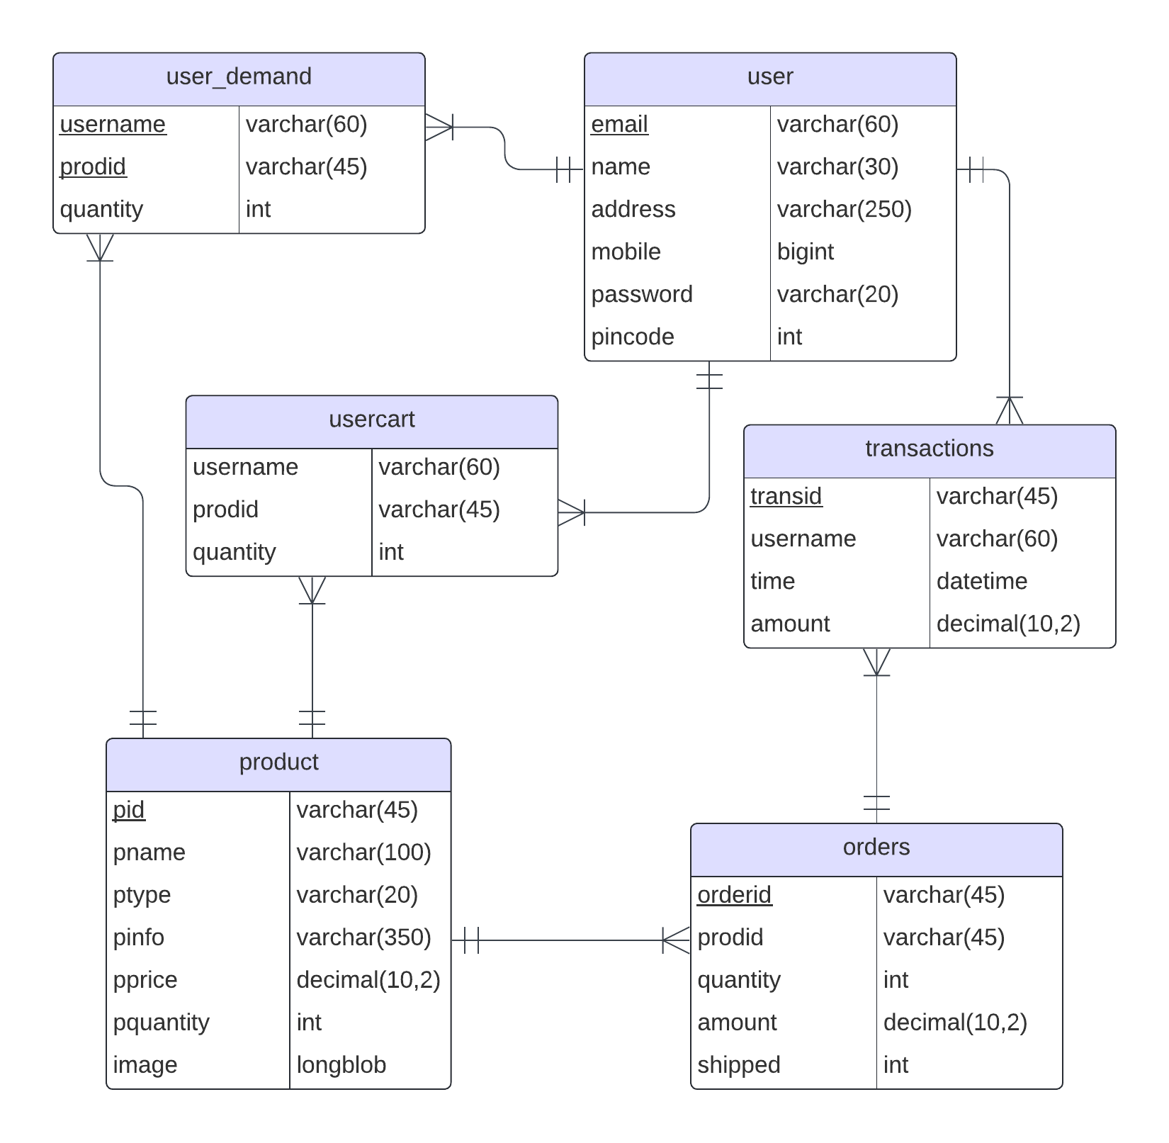
ER Diagram

Slide 7
User Side

Slide 8
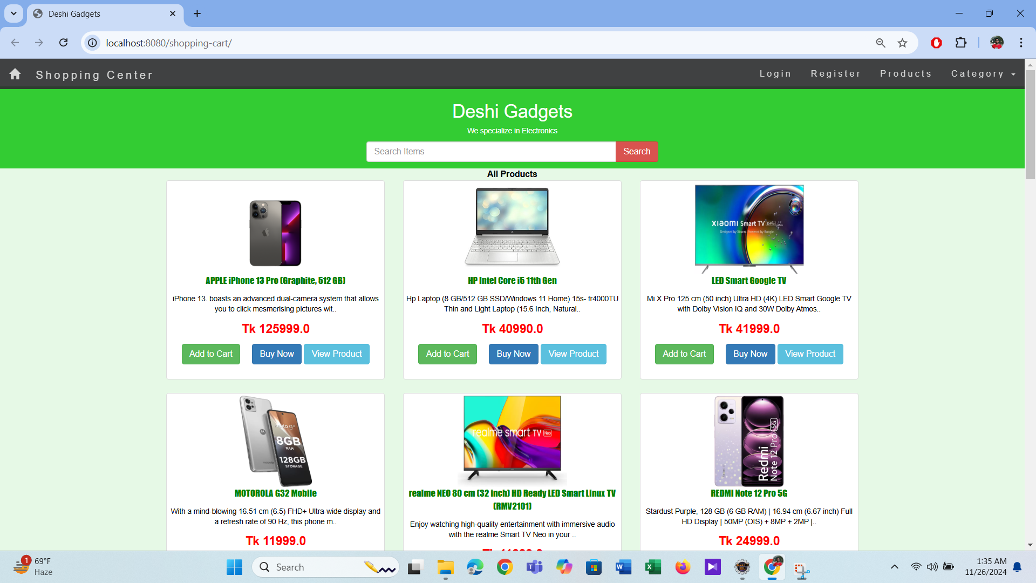
Home Page

Slide 9
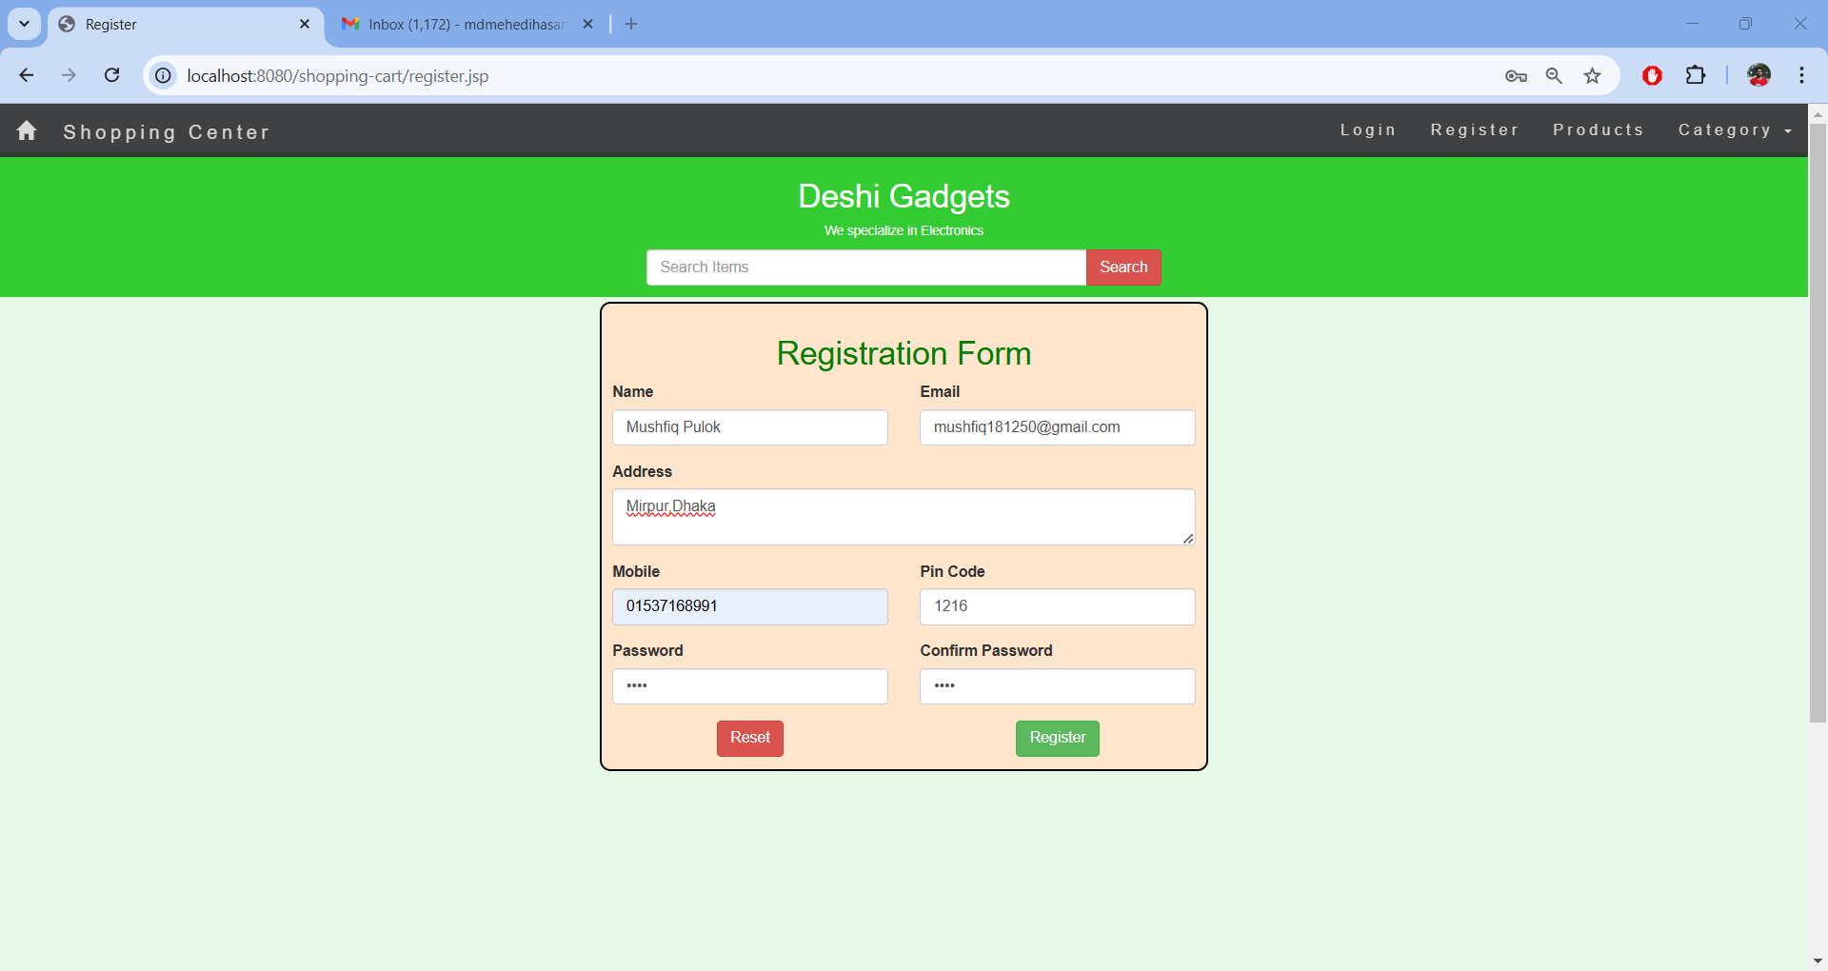
Registration Page

Slide 10
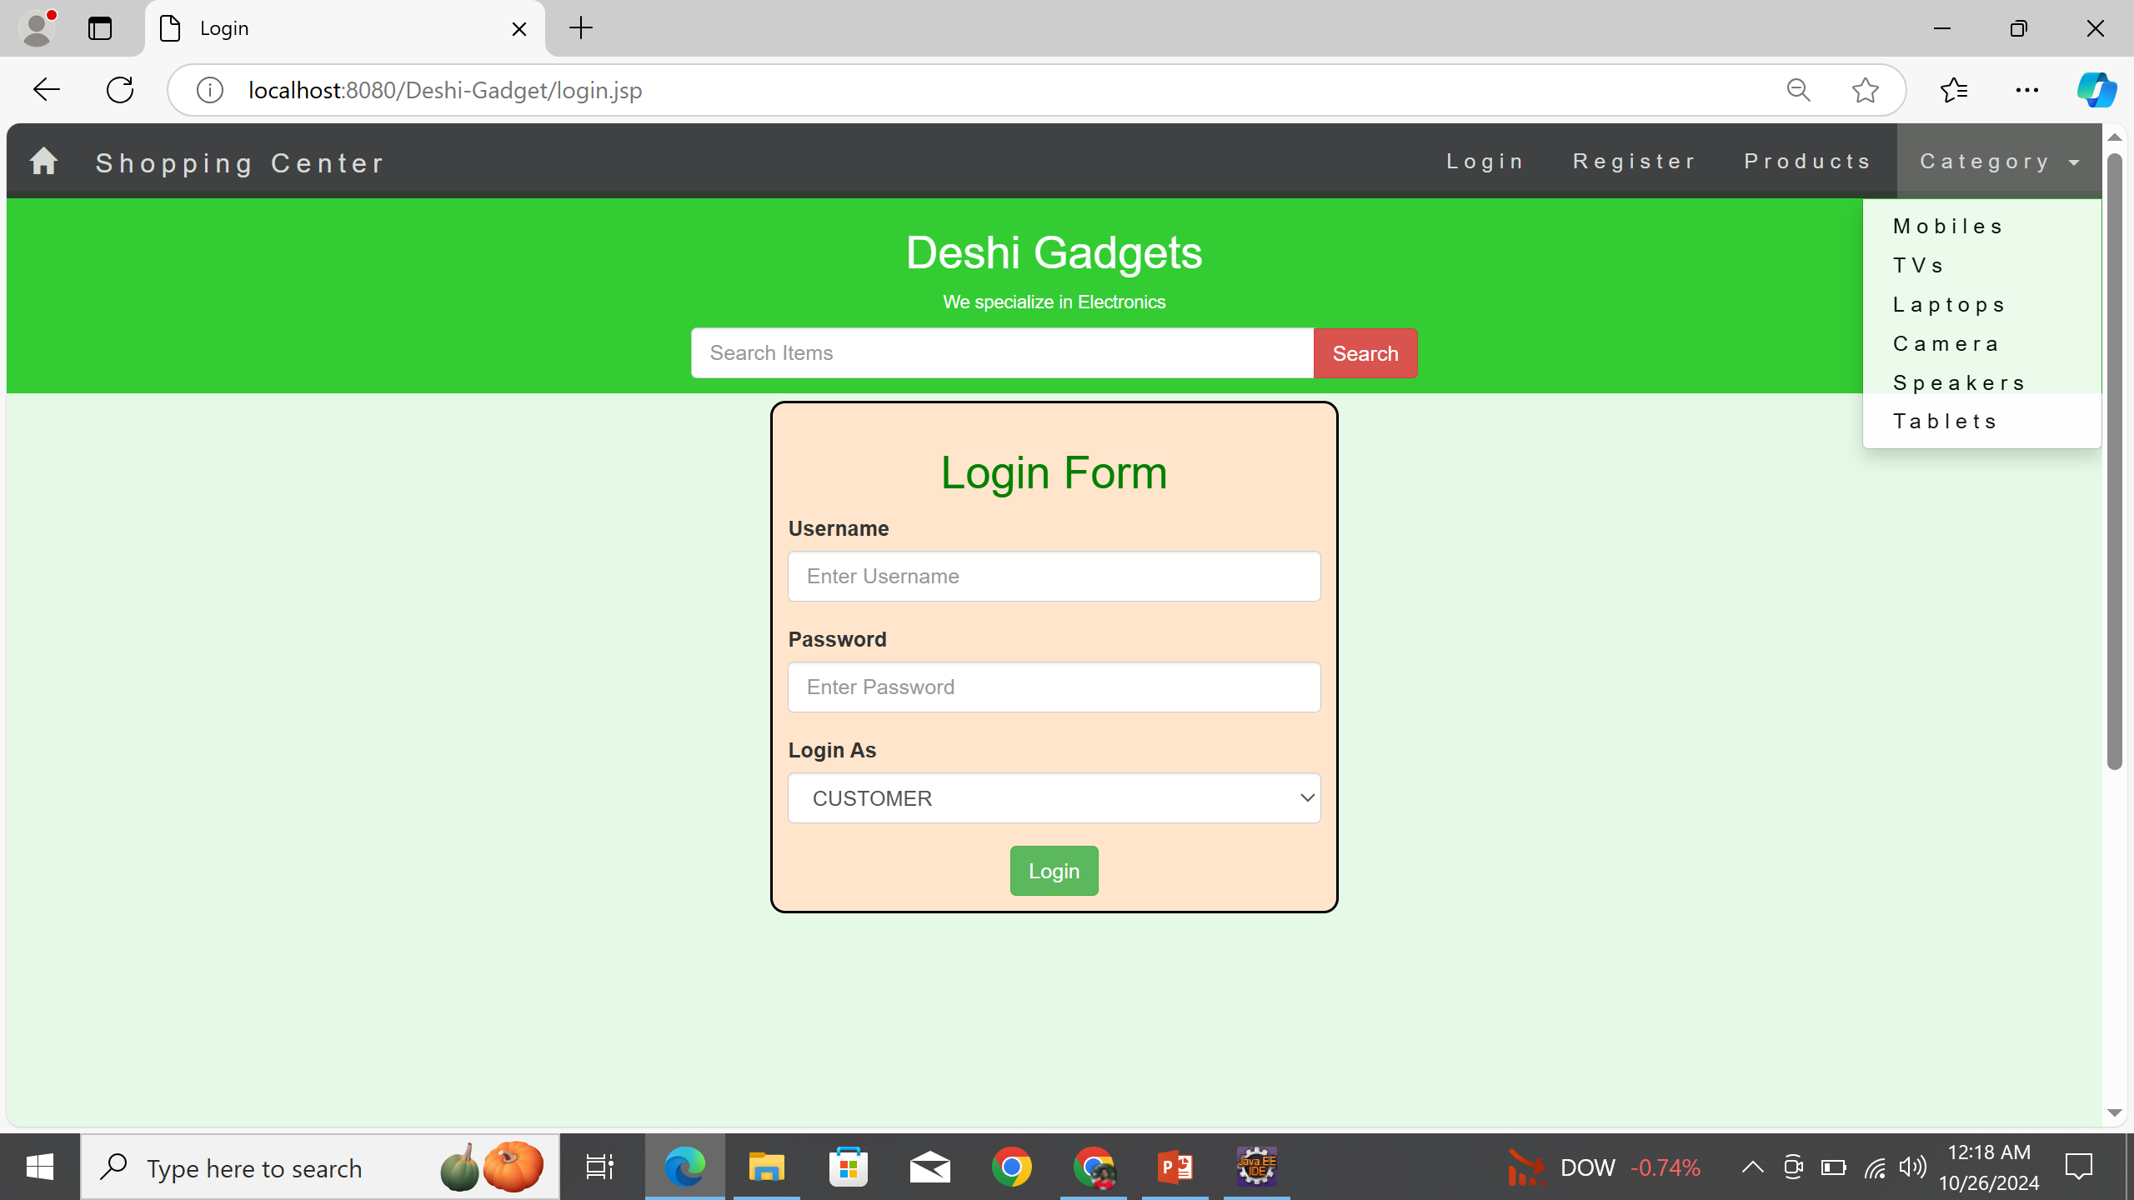
Login Page

Slide 11
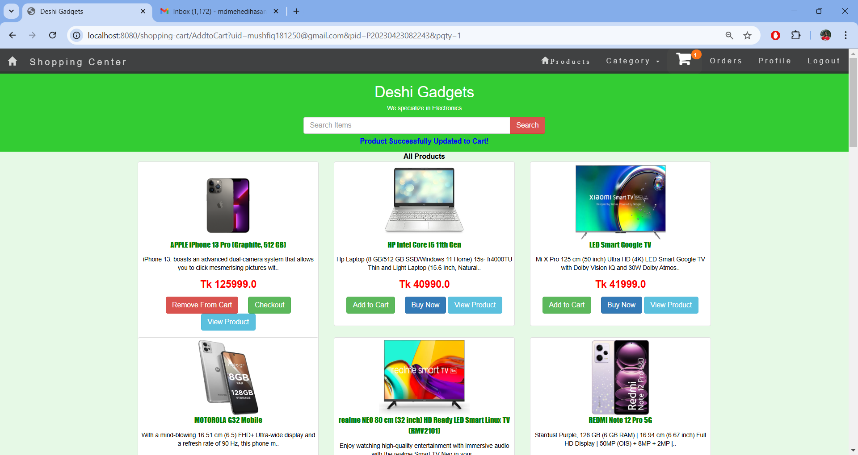
User Home Page

Slide 12
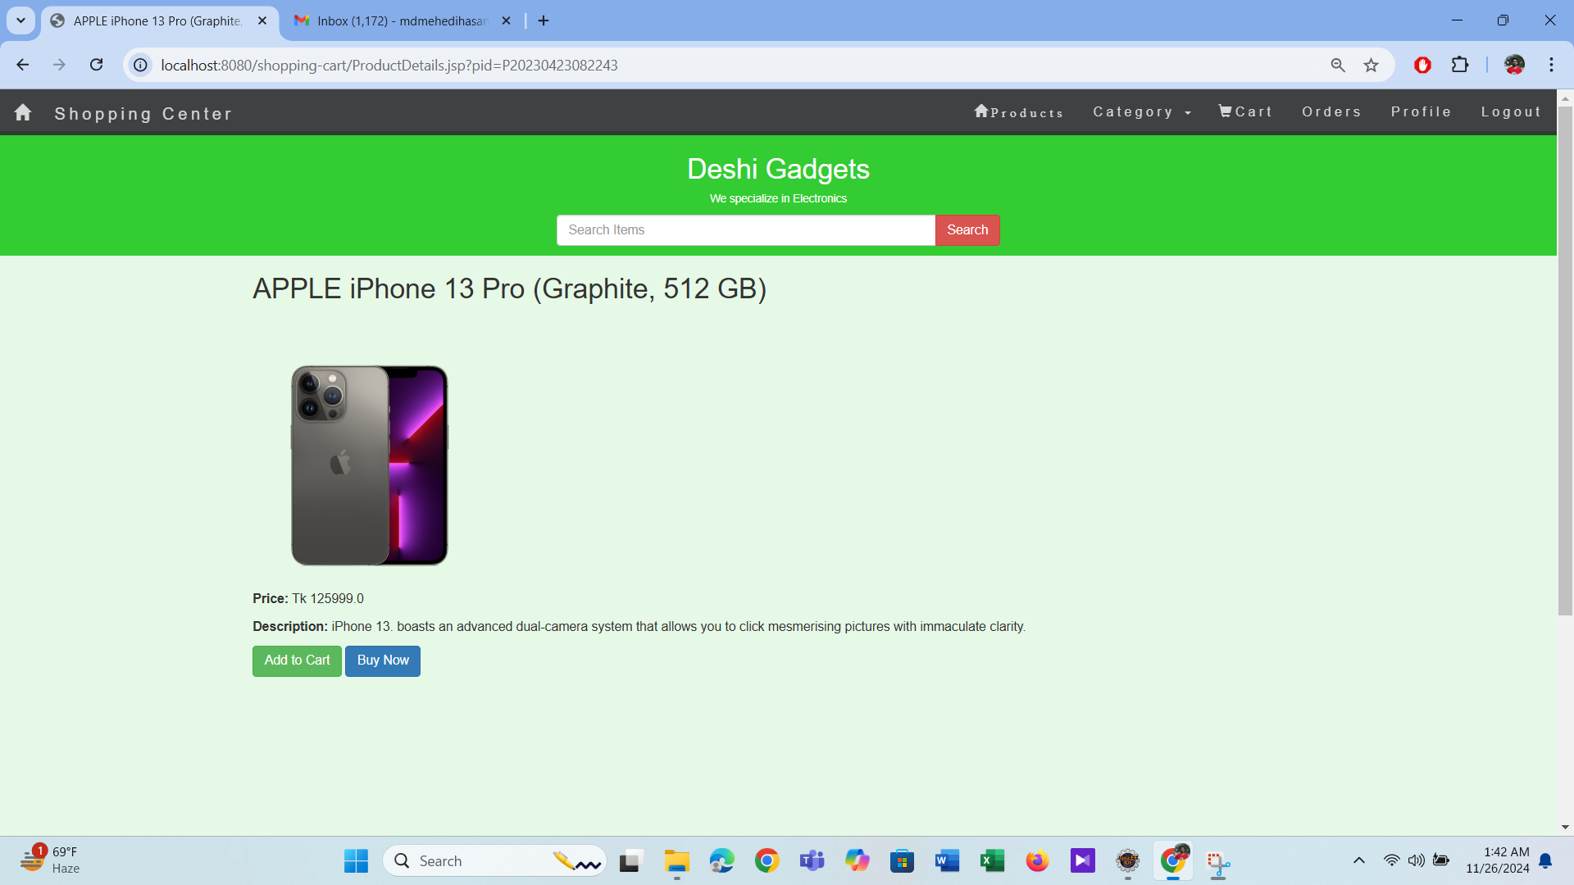
View Product Page

Slide 13
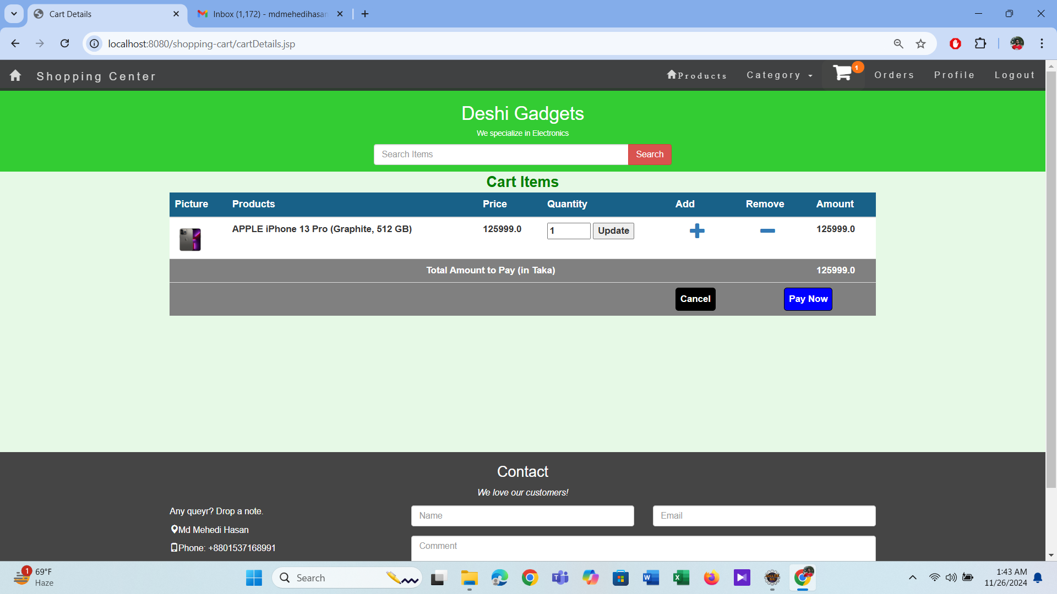
Cart Page

Slide 14
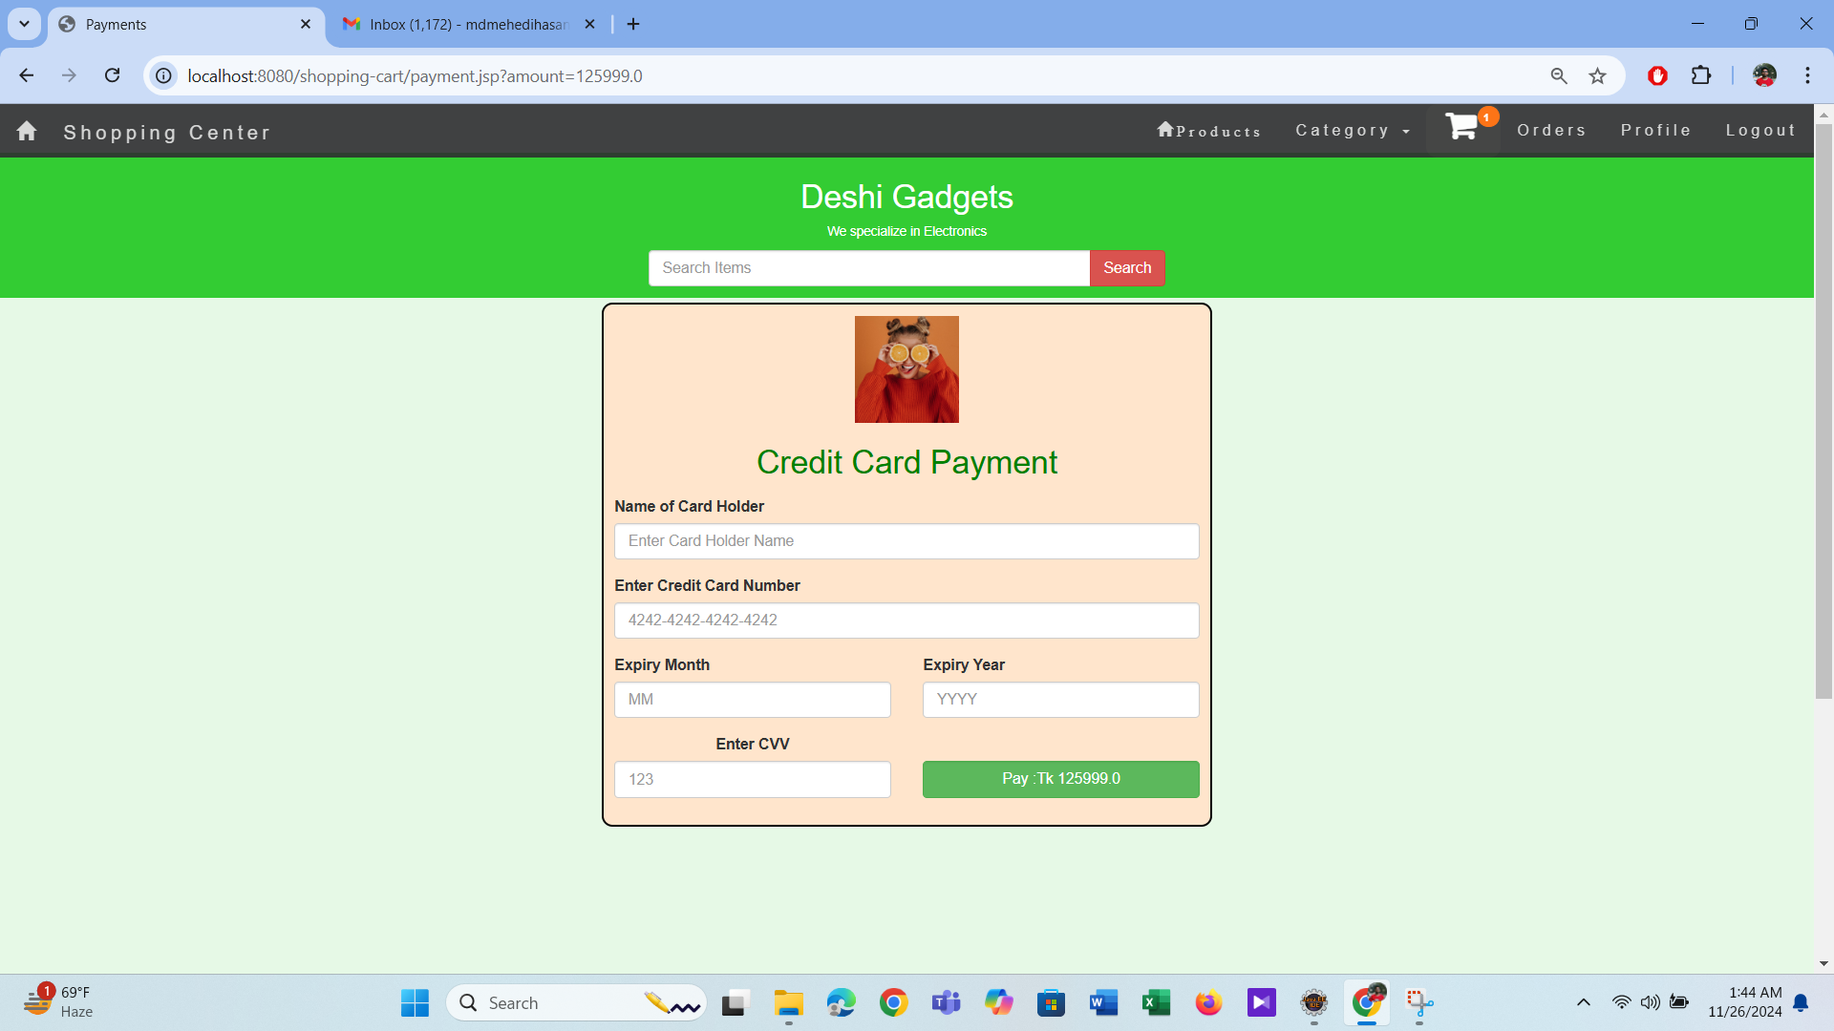
Payment Page

Slide 15
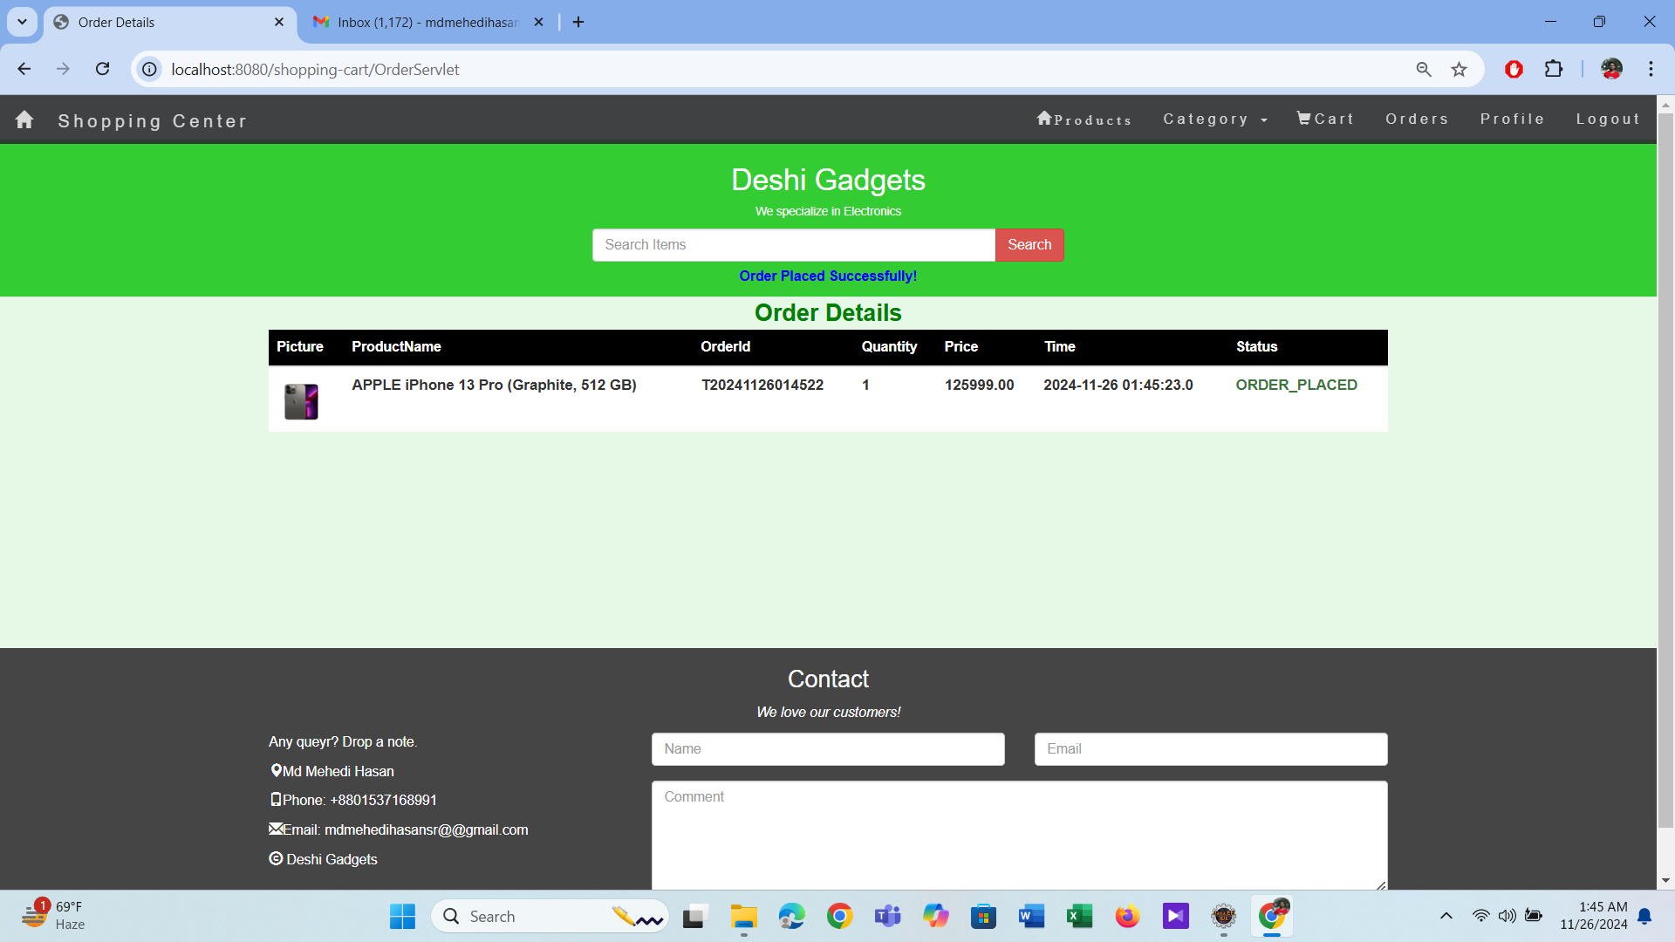
Order Details Page

Slide 16
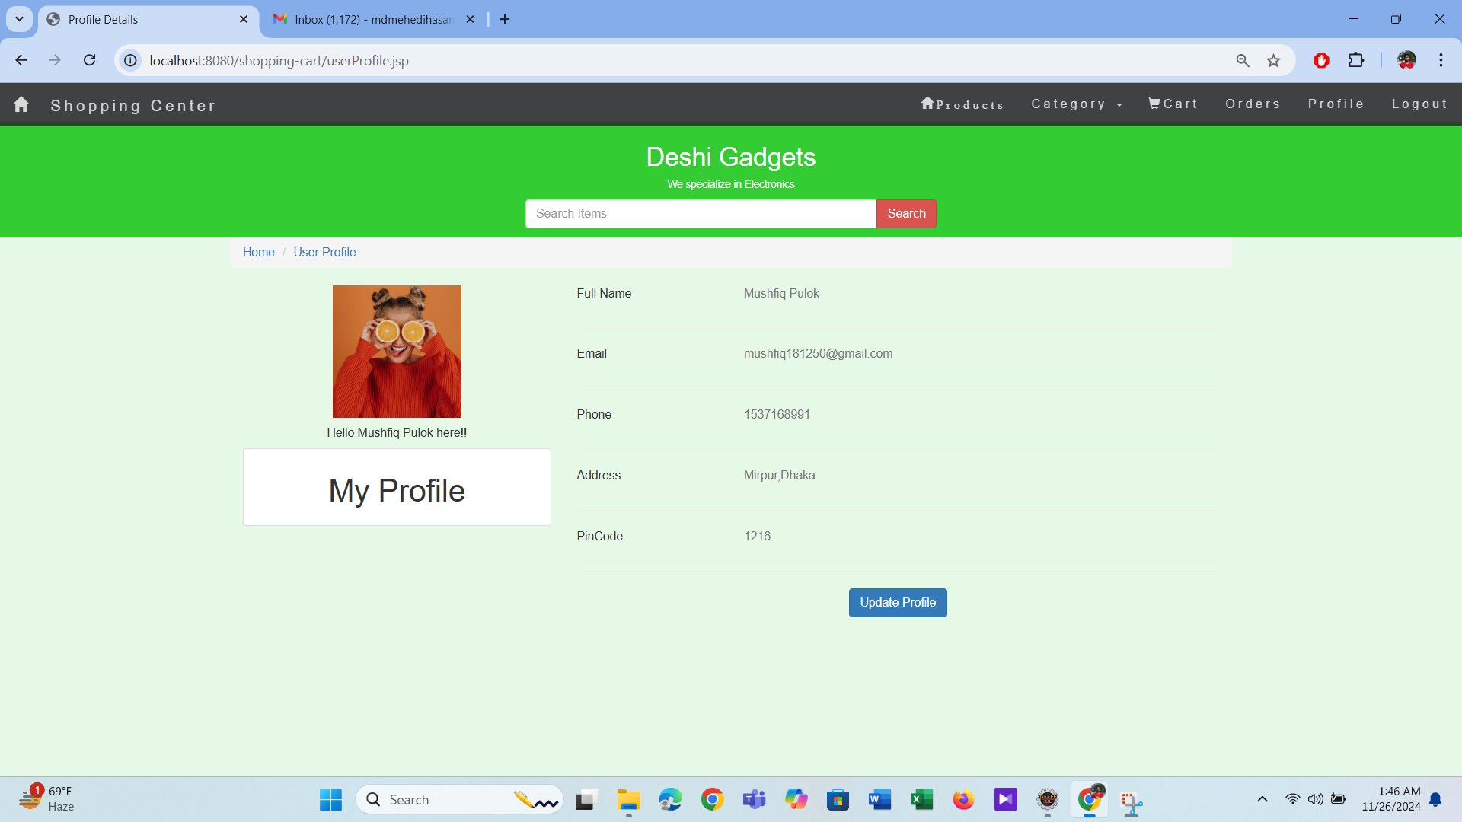
Update Profile Page

Slide 17
Mail screenshots

Slide 18
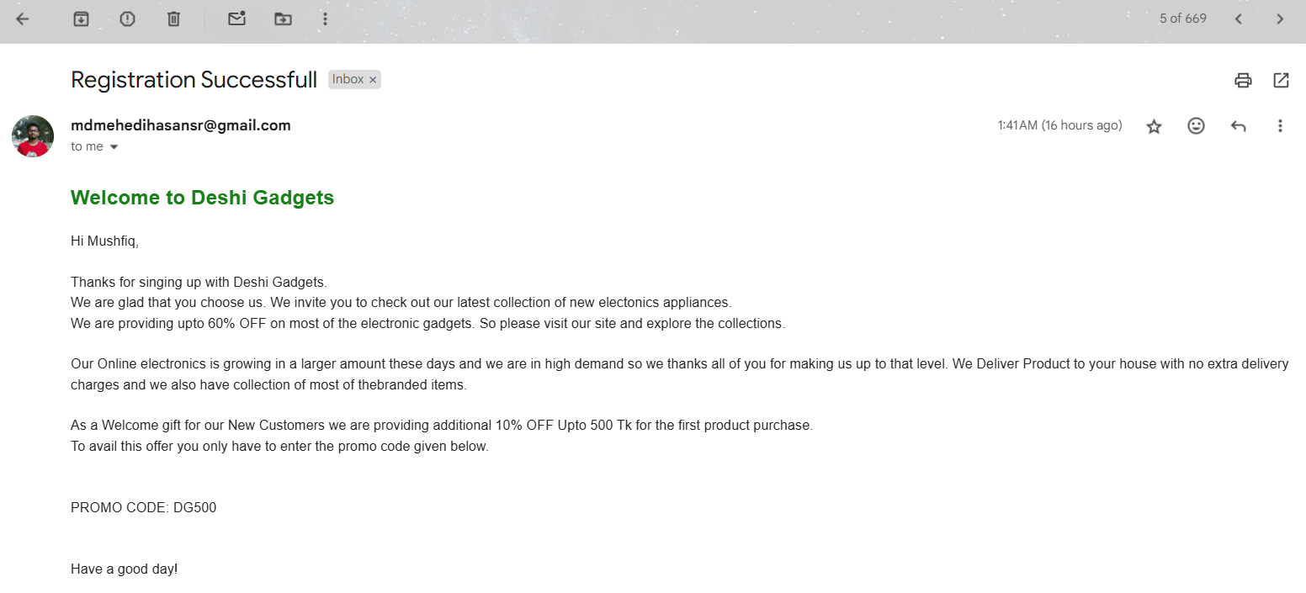
Registration confirmation mail

Slide 19
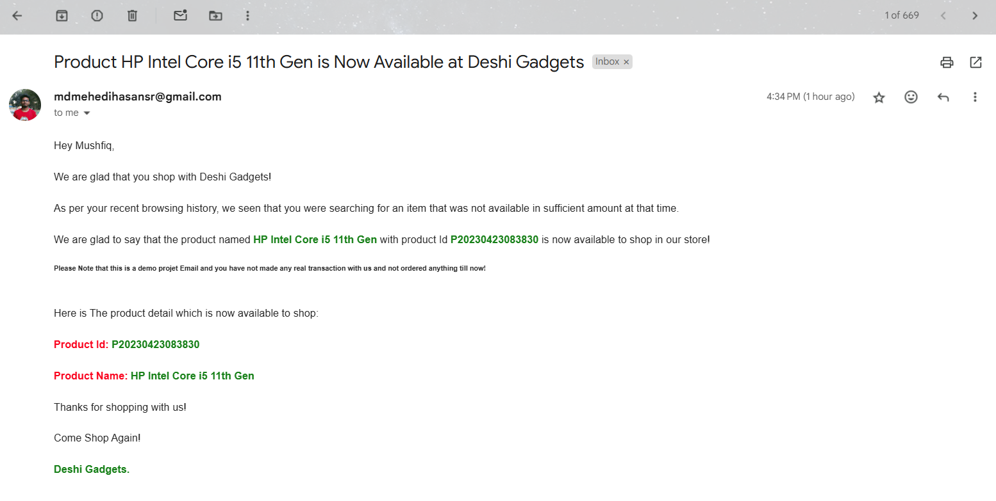
Stock availability mail

Slide 20
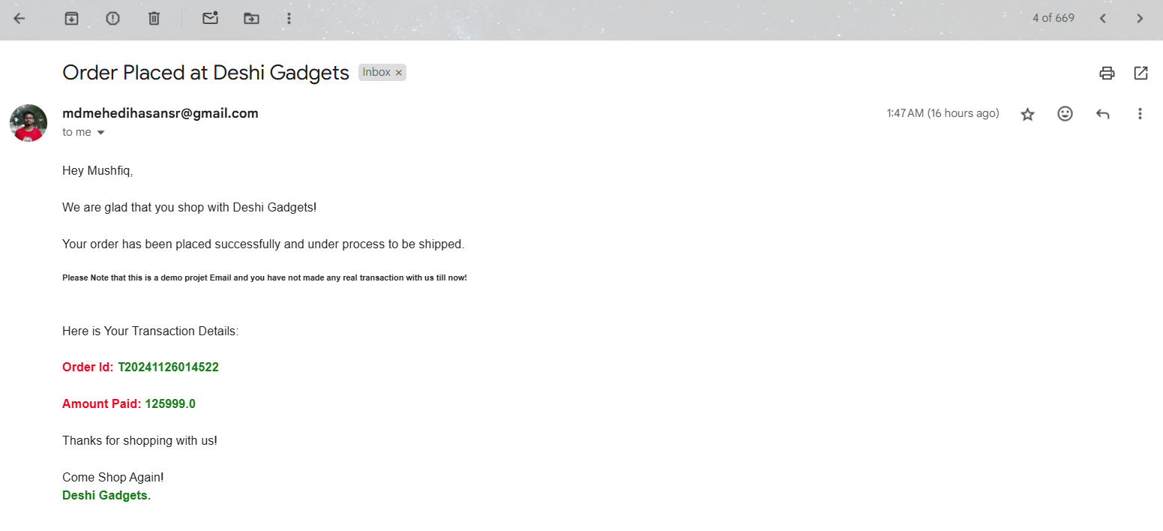
Order placed mail confirmation

Slide 21
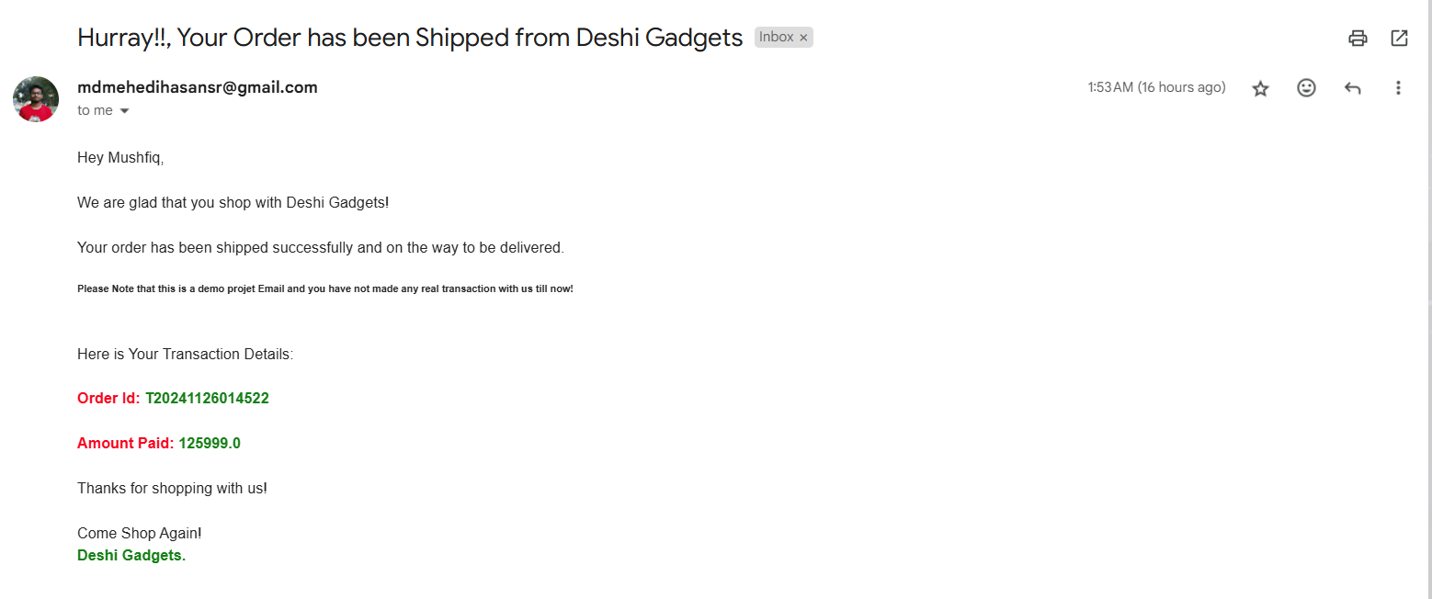
Order shipped mail confirmation

Slide 22
Admin Side

Slide 23
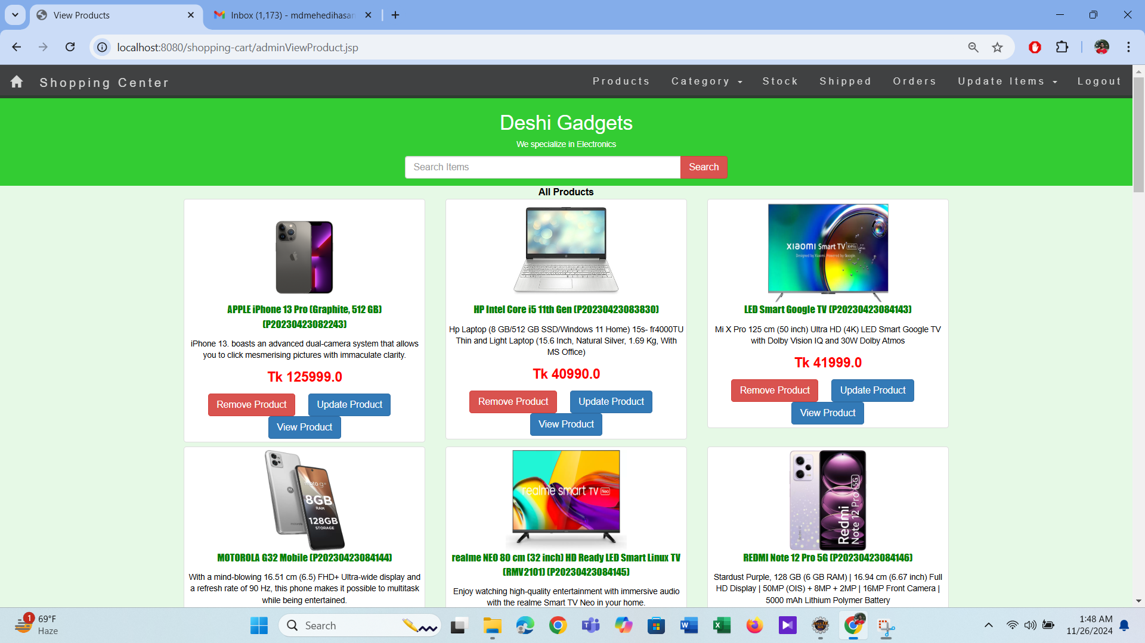
Admin Home page

Slide 24
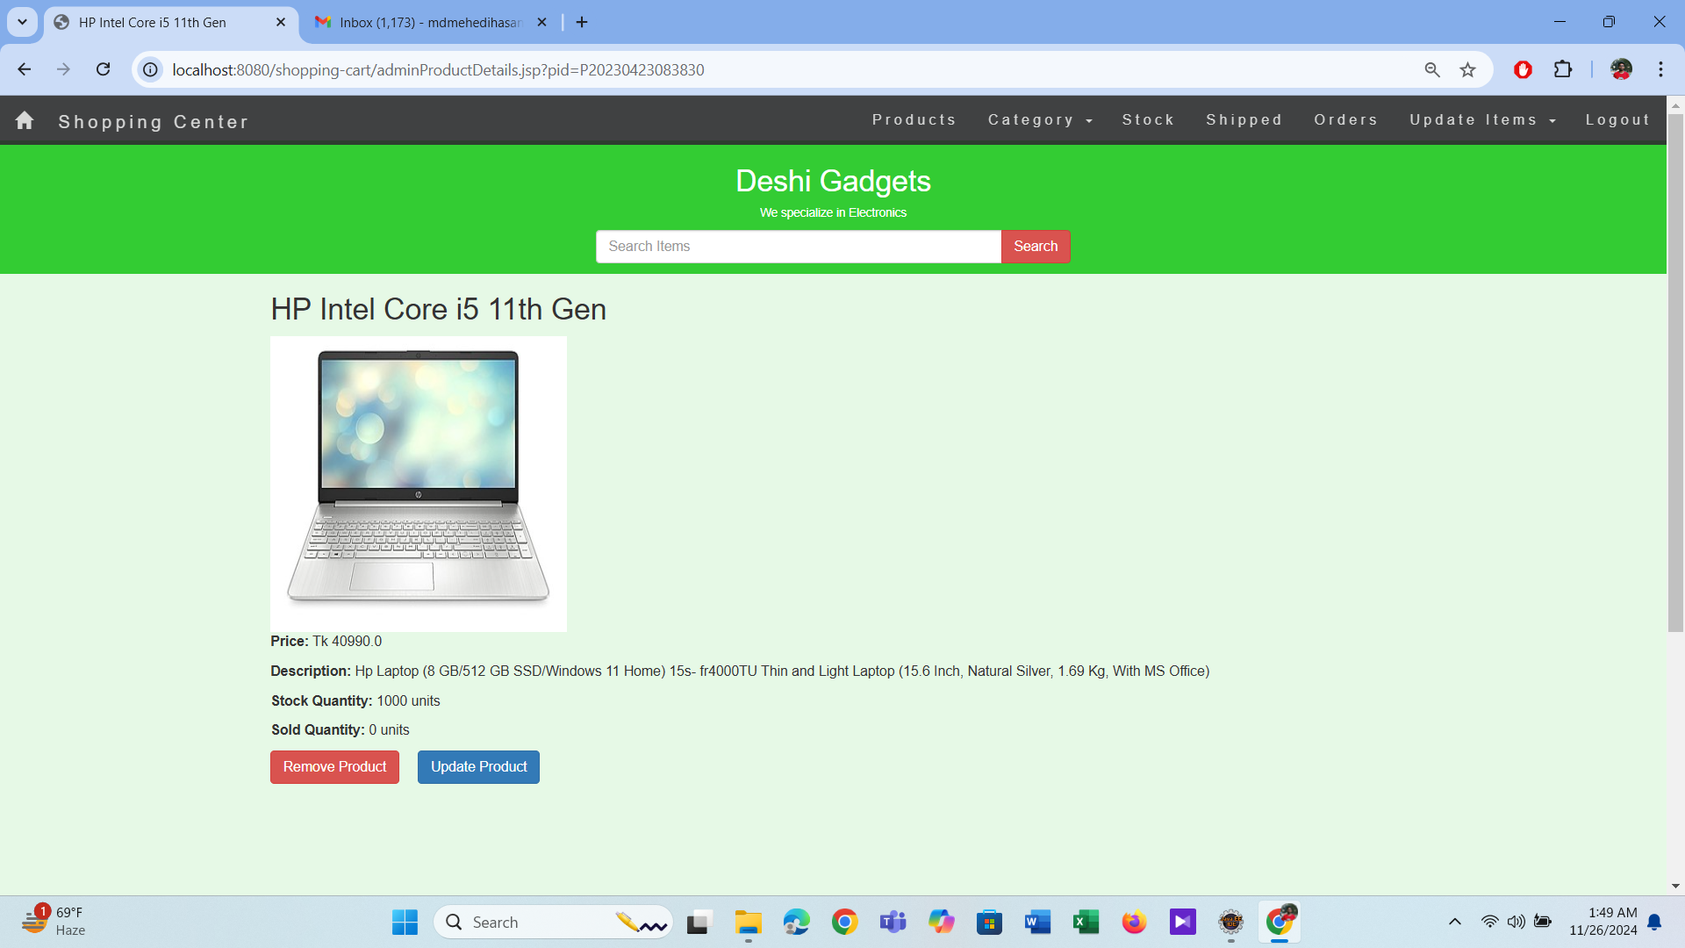
Admin View page

Slide 25
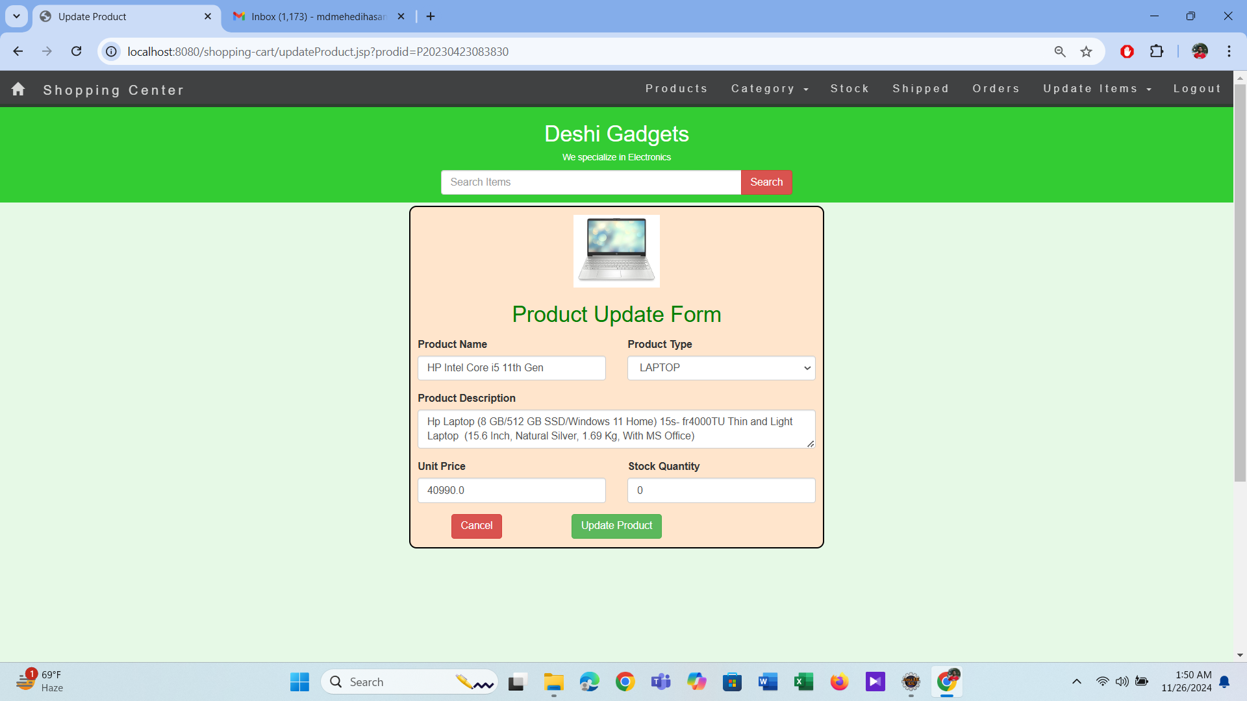
Update Product page

Slide 26
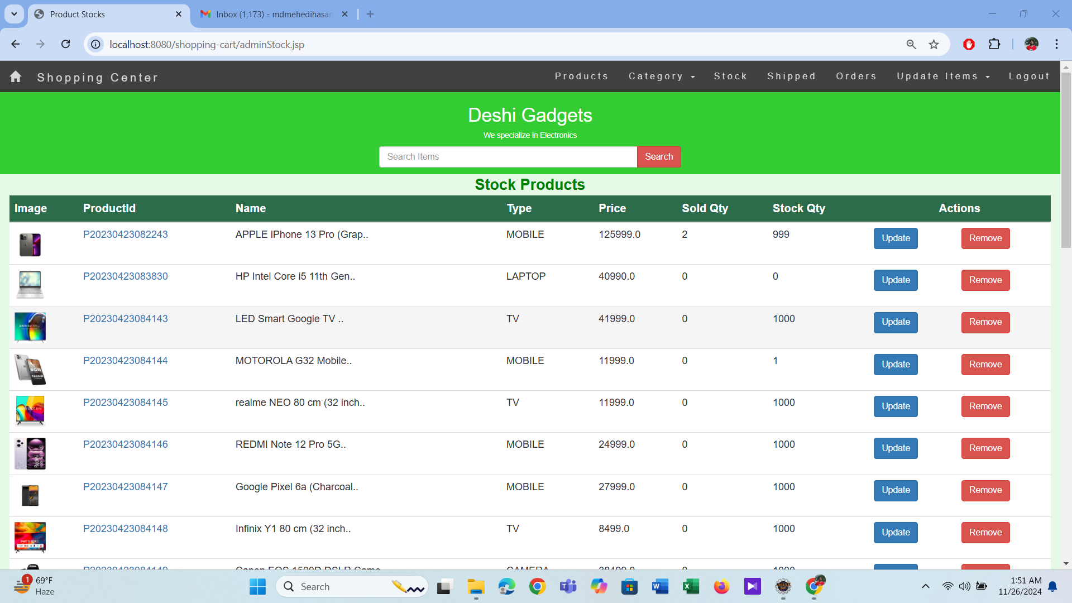
Stock page

Slide 27
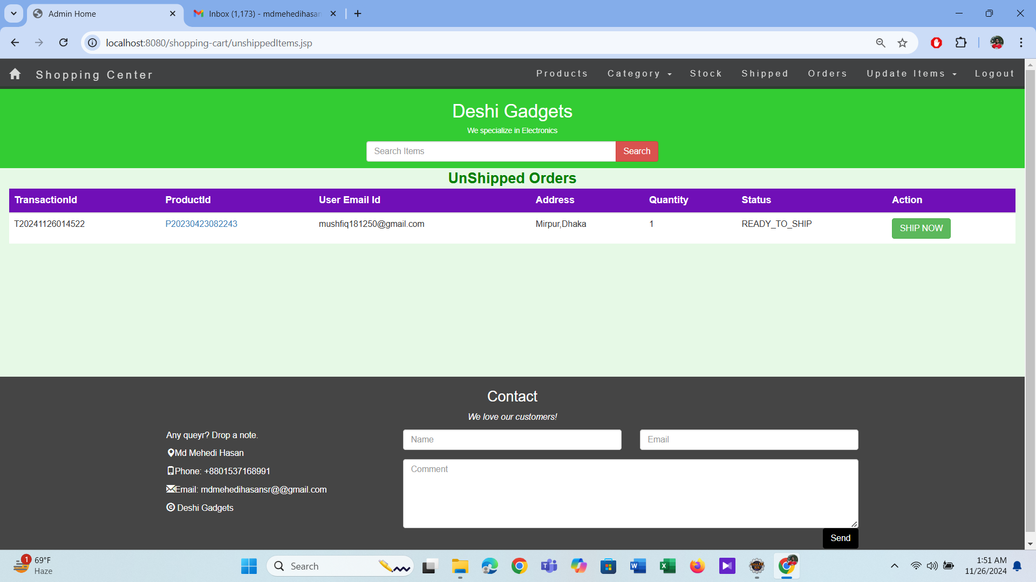
Unshipped Order page

Slide 28
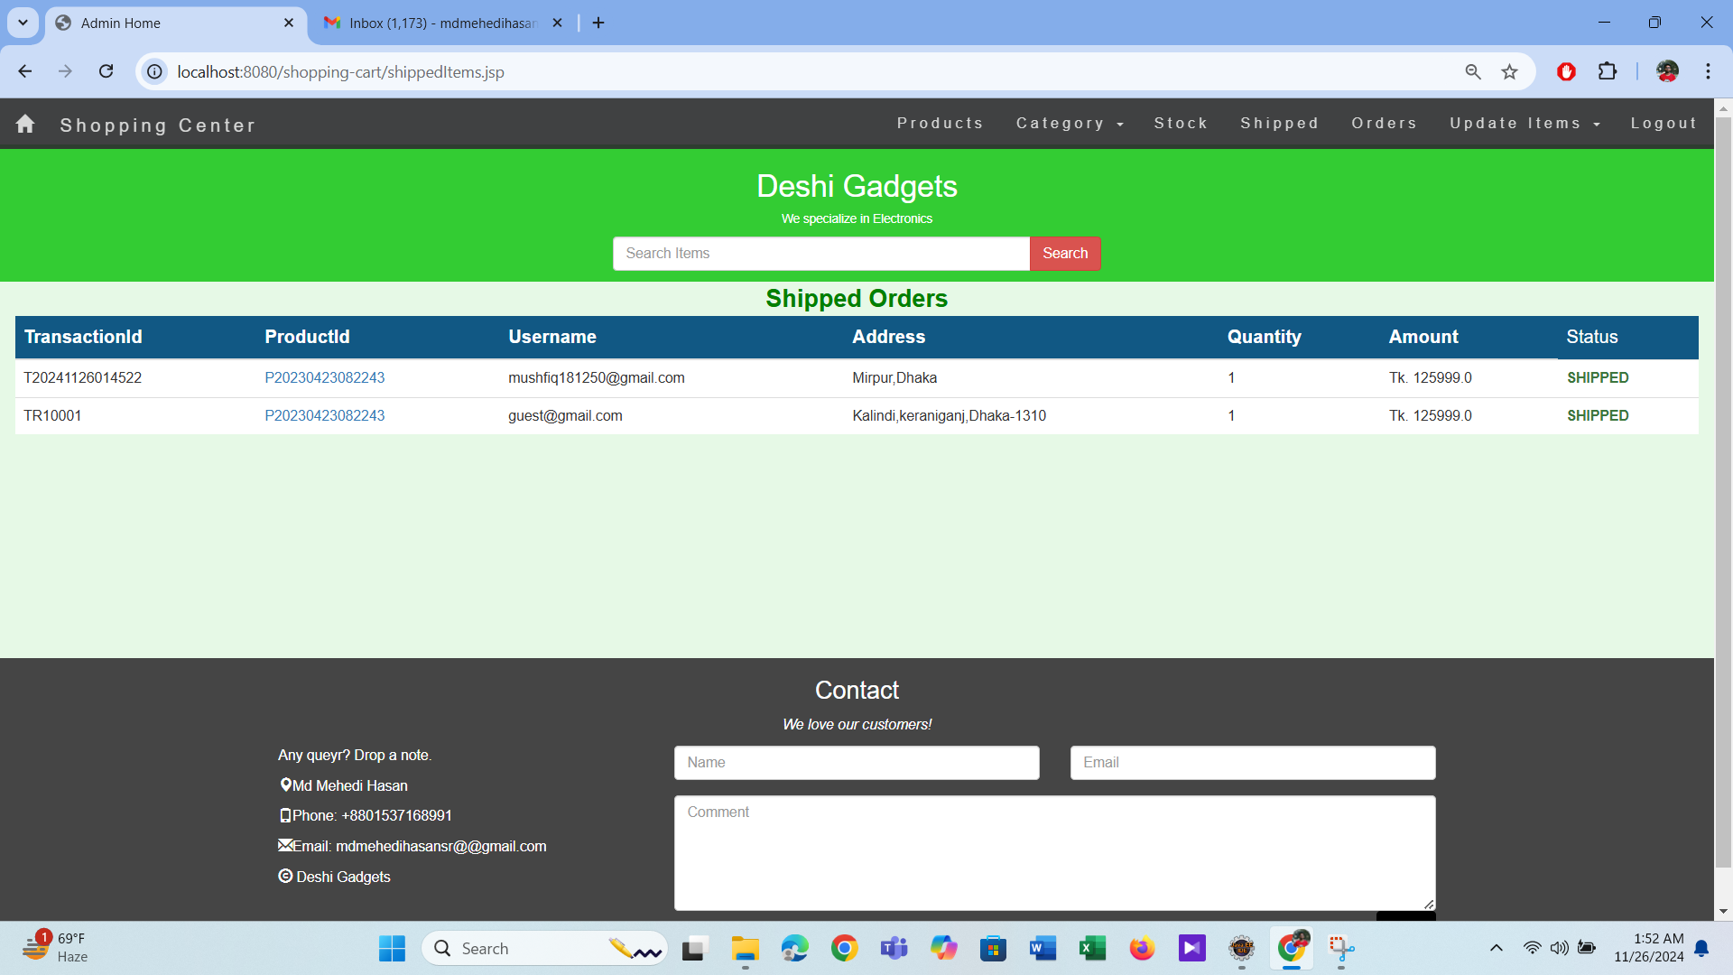
Shipped Order page

Slide 29









Tools & Techniques
Front-End Development:
Back-End Development:

Slide 30
Future Works
User features | Admin features | Enhancements | Marketing
-Product reviews & ratings. -Wishlist and AI-based recommendations. | -Advanced analytics and bulk product uploads. | -Mobile app development. -Chatbot for 24/7 support. -Multiple payment gateways. | -Discount coupons & loyalty programs. -Email and SMS promotions.

Slide 31


